Slide 1



Fundamentals of Wireless Communications
Cleaner, Smarter, More Efficient
Candice King
General Electric
Digital Energy

Slide 2

Agenda
What is Wireless?
Licensed or Unlicensed Frequency
Industry Applications
Questions

Slide 3
What is Wireless?

Slide 4
WIRELESS = AUTOMATION
As with increasing technology advancements, all market segments and industries feel the need to automate networks. This automation often comes in the form of some wireless solution. The wireless solution can come in the form of radio technology or mobile and cellular technology.
Radio technology is often referred in numerical ranges or frequencies,
hence the name Radio Frequency of RF. Frequency is the most
fundamental characteristic of a radio signal that describes the rate and
indicates the number of times per second that a signal cycle comes
from its maximum value to its minimum value and then back to its
maximum. Microprocessor based protective relays can greatly utilize
the RF of a wireless network since decisions are based on a calculated
magnitude and angle of the input waveform.

Slide 5
Radio Paths – Wireless Solution
The fundamental goal of path evaluation is meeting the
customer’s communication needs.
There are considerations that need to be discussed when determining a radio path for the network:
  Is this a primary or back-up communication system?
  Do you need continuous data throughput, or is it bursty?
  Is it point-to-point or point-multipoint?
Do these wireless locations have LOS (Line of Sight) to each other? LOS is how far you can see. This is also known as the visual horizon. Radio line-of-sight is longer than optical LOS.
Radio signals bend slightly in the troposphere, the lowest level of the earth’s atmosphere, which extends radio range compared to optical LOS. The result is that radio LOS is not the same as optical LOS—it is longer by about 1/3 as a rule.

Slide 6
Licensed or Unlicensed

Slide 7
Differentiators of
Licensed Versus Unlicensed
Cost
Private or Shared Network
System Application
Distance between Devices
Cutting-Edge Technology or Existing Proven Technology
Physical Interfaces
Data Bandwidth/Latency Requirements

Slide 8
Costs
Licensed - The fees for licensed frequencies are determined by the Federal Communications Commission (FCC) for the United States and such similar entities for other non-American countries. The fees for a pair of licenses can vary from a few thousand dollars to tens of thousands of dollars. Typically the FCC will provide a pair or 2 frequencies for a licensed system. These systems are often referred to as MAS because there is usually a Master/Host location that provides RF coverage to multiple Remote/Controller devices.
Unlicensed frequencies such as those in the Industrial, Scientific, and Medical (ISM) band (902MHz to 928MHz) do not incur a cost by the FCC, but there are rules to utilizing this frequency band. For utilization of frequencies of the ISM band (902MHz to 928MHz), the wireless devices must have a built-in mechanism that performs frequency hopping across the frequency spectrum or otherwise known as FHSS (Frequency Hopping Spread Spectrum).
Registered Band - Some wireless networks take advantage of registered band frequencies that are considered “unlicensed”. The advantage of using a registered band is that it is similar to a licensed band in that you are allowed to have devices on one particular frequency without having to “hop” among different frequencies, but you do not have to pay a fee to the FCC for any particular frequencies. Currently, this registered band includes frequencies ranging from 3650MHz to 3750MHz.

Slide 9
Private or Shared Network
Private/Licensed - In a licensed network, you own the network and it is considered a private network you control when outages can occur. Some customers will often test run for outages and have the capability to do so since they will only be affecting their network.
Other users operating in licensed frequencies opt for this more expensive wireless solution because the application that requires monitoring or connectivity to wireless devices are important and cannot afford the risk of having unavailability or downtime throughout the year.
Unlicensed frequencies - Do not incur a cost by the FCC, but there are rules to utilizing this frequency band. For utilization of frequencies of the ISM band (902MHz to 928MHz), the wireless devices must have a built-in mechanism that performs frequency hopping across the frequency spectrum or otherwise known as FHSS (Frequency Hopping Spread Spectrum). This technology may seem unattractive in that the signal is constantly moving, but what makes it attractive is the higher bandwidth capabilities.

Slide 10
Distance Between Devices
Frequency MHz
Distance in Miles
Notes:
900MHz can be either licensed or unlicensed

Slide 11
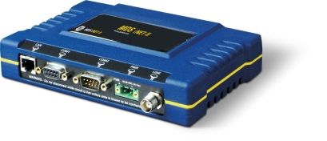
Physical Interfaces
*There are some wireless devices that may support both Ethernet and/or serial and then there are those devices that support only one or the other.
RJ45 port for Ethernet connectivity
2 independent RS232 ports for serial connectivity
Serial devices operate at much slower speeds than those devices connected to Ethernet ports. The serial devices allow connectivity to devices that do not require high latency or quick response times.

Slide 12
Data Bandwidth Requirements
Prior to deciding which frequency for a network, the application for the radio use will assist with dictation of which frequency range to utilize. Applications such as recloser control and Volt/VAR control may require a radio device that can provide a high bandwidth/fast speed solution. Other SCADA applications such as sensor monitoring may only require small bandwidth and for data delivery to be at a much slower speed.
Some examples of applications that do not require quick responses are those systems that may do a system poll and only require a response when or if there is a problem. Other applications with low latency or response times are those that monitor a system for an ON or OFF response.
Serial devices often operate in the 4800 to 9600 bits per second data realm, they are often the most reliable and provide the longest coverage range with respect to distance.
Ethernet devices often operate in the 19,200 bits per second up to 30 megabits per second data realm.

Slide 13
APPLICATIONS

Slide 14
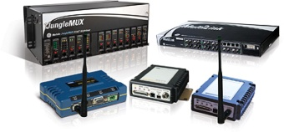
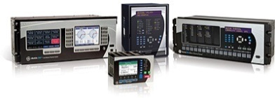
Wireless Products
Protection and Control

Slide 15
Cement / Mining
WiFi/Cellular
900MHz Unlicensed
2.4GHz Unlicensed
Fiber Optics / Microwave Backhaul
Network Management Systems

Slide 16
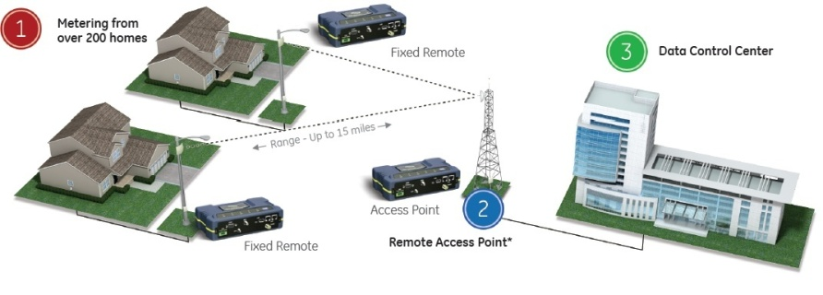
AMI (Advanced Metering Infrastructure)
With the addition of wireless devices for the AMI application, utility companies not only have the ability to “read” meters remotely, but billing is now the most accurate it has been since consumers are now billed based on actual usage and not on usage that was rounded to the nearest kilowatt as done in the past.

Slide 17
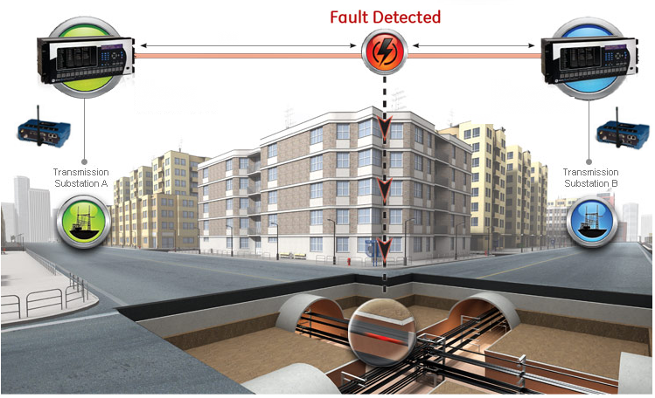
Point-to-Point
IEC61850 GOOSE Messages

Slide 18
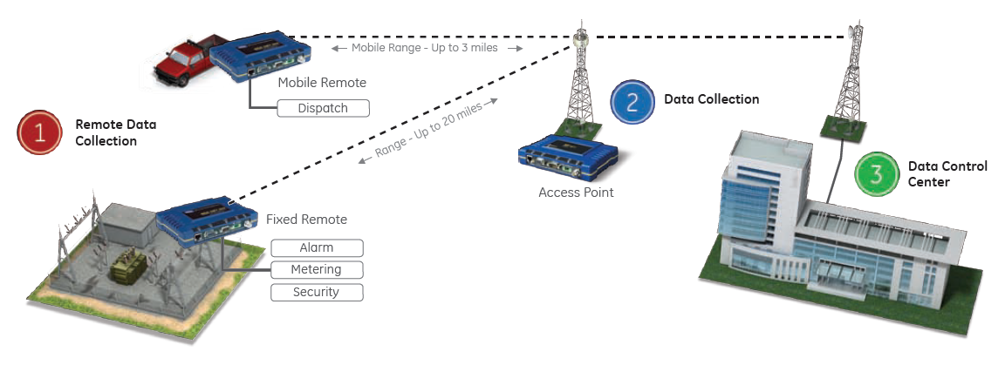
Point-to-Multi-Point
Field utility and industrial applications exist today using Ethernet over radios interfaced with Ethernet based protective relays for data and control (DNP protocol, IEC61850 protocol)
Protection Relays

Slide 19

Questions

Slide 20
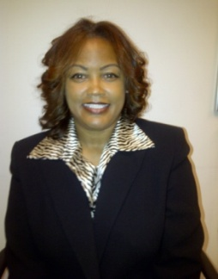
About the Author
I am currently in the role of Sales Technical Application Engineer (TAE) for Industrial Communications in the GE Digital Energy Commercial organization. I have been in the role since July 2011 and most recently tasked with strengthening focus of wireless communications in the Oil and Gas vertical in August 2014. I am responsible for providing pre-sales technical support to sales manager s and customers that includes product demo set-up and evaluation, RF propagation studies and creating system solutions that provide a seamless integration of our current communication products within our customer’s applications. I have over 17 years of experience in telecommunications with technical roles in field service, validation engineering, service engineering, and project analytics.
I began my career with GE in 2009 as a member of the Microwave Data Systems (MDS) team based in Rochester, New York as a Project Engineer but quickly earned increasing responsibilities. I was part of a team implementing the first WiMax 3650 MHz communication Smart Grid solution in North America for Centerpoint Energy in Houston, Texas. Prior to joining GE, I worked for a major Canadian telecom equipment maker as test and validation engineer, a technical support engineer, as well as a lead engineer supporting many of the major telecom carrier providers in the telecommunications industry.
I hold a Bachelor of Science degree in Mathematics from Prairie View A&M University and Master of Business Administration from Amberton University. My memberships in IEEE (Institute of Electrical and Electronics Engineering), SWE (Society of Women Engineers) and NSBE (National Society of Black Engineers) allow me to remain on the cutting edge of the communications industry.
I am currently based in Dallas, Texas.
Candice.King@ge.com
www.gedigitalenergy.com/Communications

